Slide 1



Slide 2


Slide 3


aaaaa

Slide 4


Slide 5

0
1
2
3
4
Original_gun
Soul_gun
Firing_gun
Infinite_magic
Infinite_firepower

Slide 7


Slide 8
Player1
HP
MP
Player2
HP
MP

Slide 9
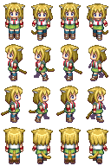
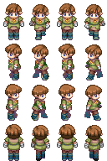
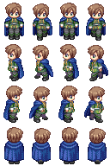
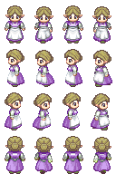

Slide 10
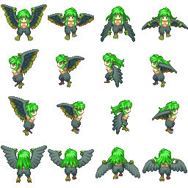
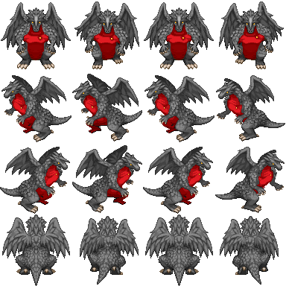


Slide 11

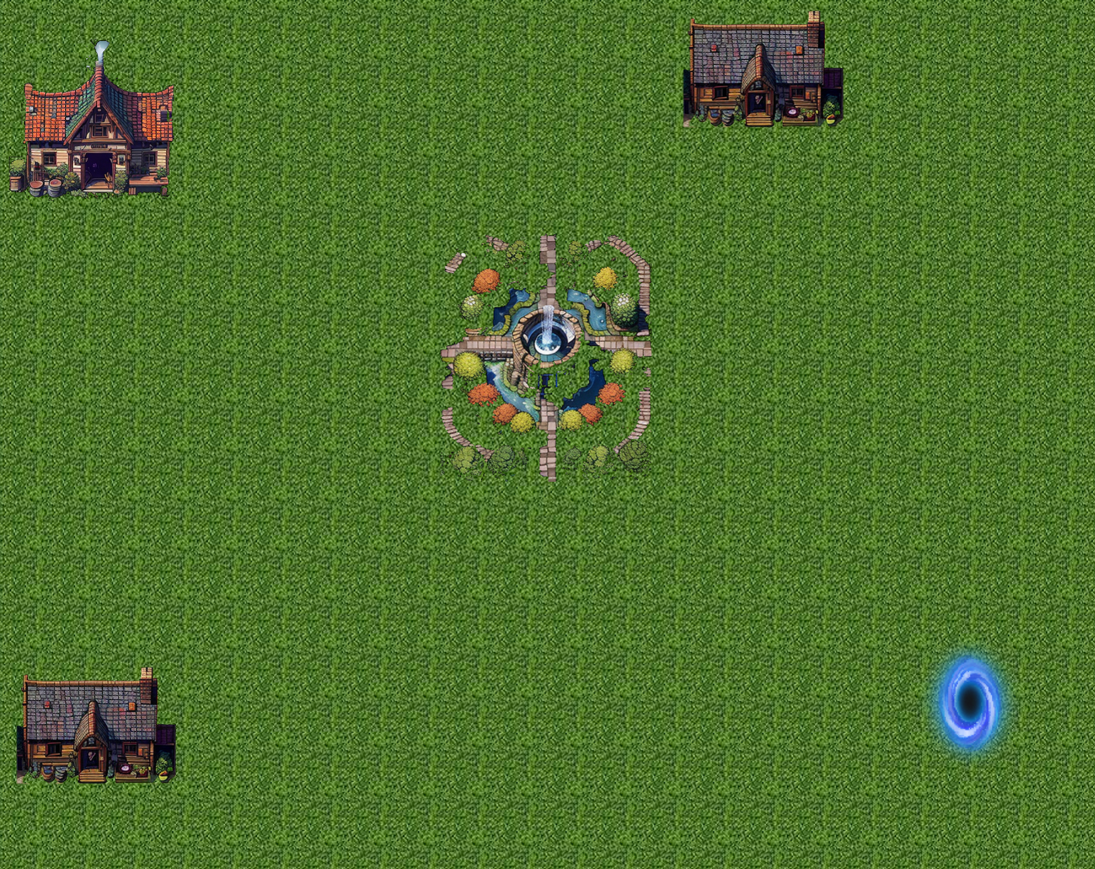


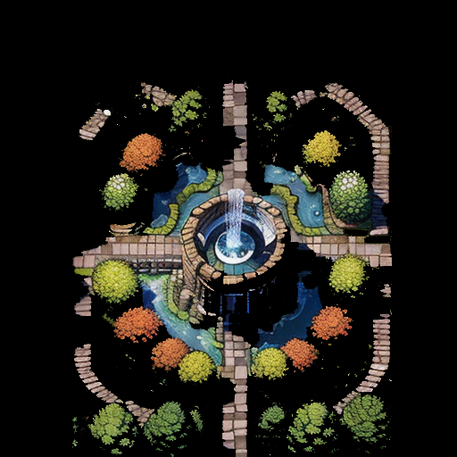

Slide 12
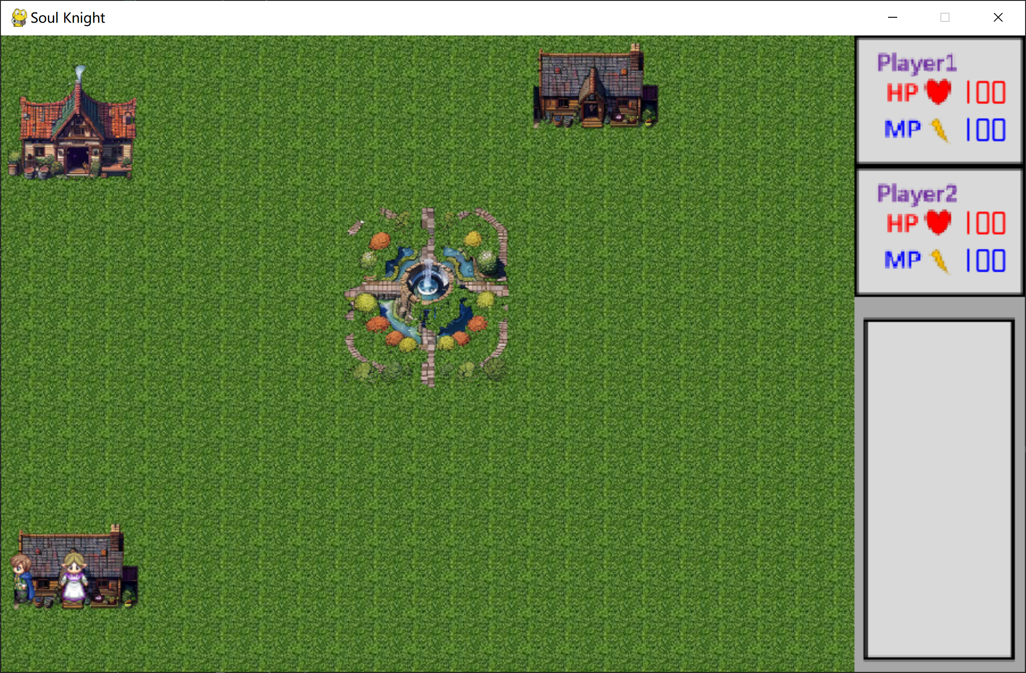
750 * 560
150 * 115
150 * 115
150 * 330

Slide 13
